Slide 1
IST687 Project Update
Agile Kanban Methodology
ADS Group 4
Jacob Dineen
Mason David
Mohamed Khalifa
Zhaowei Jiang
Kellie Mosely

Slide 2
Kanban Board
BACKLOG | IN-PROGRESS | ANALYSIS | DEPLOYED
 | Addressing issues Scope defined Data assessment Initiating the process of data cleansing Defining team responsibilities

Slide 3
Team Page
Trello Link
https://trello.com/b/lXdbFrjQ/

Slide 4
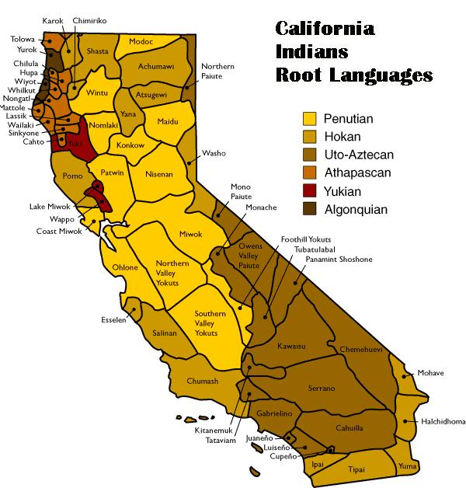
What’s the scope
file-> out-201501rv
Area of focus
Demographic/ Behavior
Amenities
Hotel/Brand Classification

Slide 5
Business Question
What’s our target region?
Is there a relationship between audience demographics/behavior and NPS?
What specific criteria “amenities” contribute to higher NPS?
What recommendations can we provide to our clients to maximize the overall NPS?

Slide 6
Overall Summary
Accomplishments this past period
Team introductions
Overview of project
Assessing the data
Defining scope of business analysis
Understanding audience segmentation
What is working well
Active Participation
Communication
Team Bonding
Brainstorming
Organization
Plans for next update
Addressing issues
Data assessment
Initiating the process of data cleansing
Defining team responsibilities
Issues / What is not working well
Finding relevant columns / variables to analyze in large data set
Data Understanding | Preprocessing | Analysis | Testing | Communicating Results
40% of time / 4 people | 40% of time / 4 people |  |  | 20% of time / 4 people

